Slide 1
Cloud Operating Systems
and OS-Level Virtualization
Course: Operating Systems
Presented by: ROHIT L
Register Number: 192511236
Department: AIDS
Institution: SIMATS Engineering

Slide 2






What Is a Cloud Operating System?
A cloud operating system is a software environment that helps manage computing resources such as processing power, memory, storage, and networking across cloud infrastructure.
Cloud platforms are not necessarily operating systems themselves. They provide cloud infrastructure and management services that work alongside traditional operating systems.
Manages computing resources.
Supports applications and services running in the cloud.
Enables remote access to computing resources.
Helps allocate resources based on demand.
Real-world examples: Google Cloud, Microsoft Azure, Amazon Web Services (AWS).
Supports scalability and centralized management.
PROJECT LEDGER
PUBLIC INTEREST REPORT
02 / 10

Slide 3



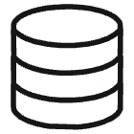

CASE NO. PL - 0426
How Cloud Computing Works
Cloud computing allows users to access computing resources over a network instead of relying entirely on their local computers.
A user accesses a cloud application through a browser or client.
The request travels through the internet.
Cloud servers process the request.
The required data or service is retrieved.
The result is returned to the user.
Diagram: User Device → Internet → Cloud Servers → Database/Storage → Response to User.
Client: Laptop, smartphone, or desktop.
Network: Connects the user to cloud infrastructure.
Servers: Provide computing power and memory.
Storage: Stores files, databases, and application data.
Management software: Allocates resources and monitors workloads.
Example: When a user opens Google Drive, files are accessed from cloud infrastructure rather than only from the device's local storage.
PROJECT LEDGER
PUBLIC INTEREST REPORT
03 / 10

Slide 4
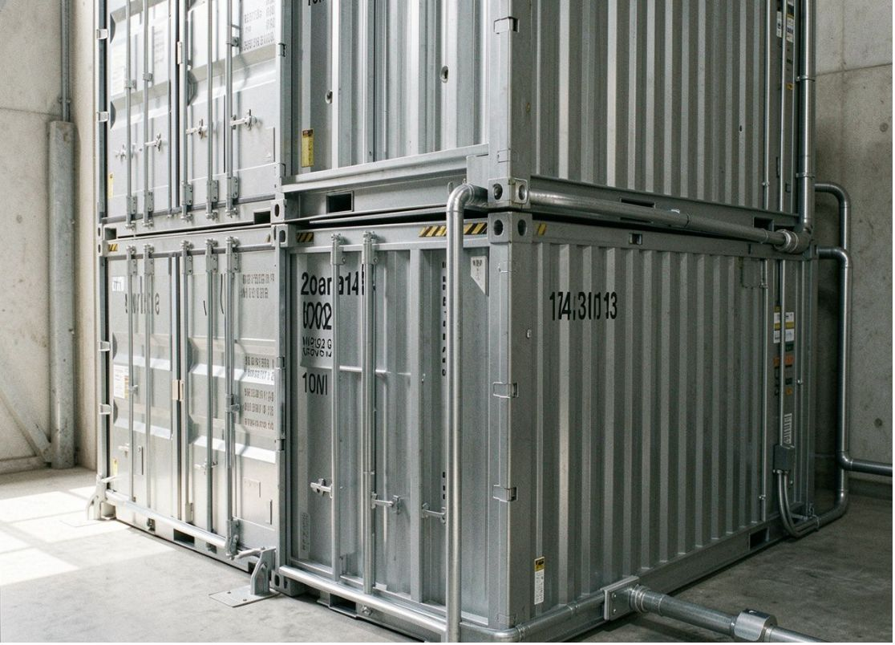
What Is OS-Level Virtualization?
OS-level virtualization is a technique in which a single operating system kernel creates multiple isolated environments called containers. Each container can run its own application and required libraries while sharing the host operating system's kernel.
The host operating system provides the kernel.
A container engine creates and manages containers.
Each container runs its own application processes.
Isolation helps separate applications from one another.
Containers can use CPU, memory, and storage limits.
Popular technologies: Docker, Podman, Linux Containers (LXC).
Example: An organization can run a website, an API, and a background processing service in separate containers on one server.
PROJECT LEDGER
PUBLIC INTEREST REPORT
04 / 10

Slide 5
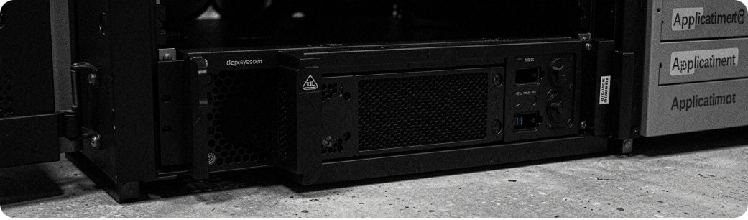
Architecture of OS-Level Virtualization
Physical Hardware: CPU, RAM, storage, and network interfaces.
Host Operating System: Manages the hardware and provides the kernel.
Container Runtime: Creates, starts, stops, and manages containers.
Containers: Isolated environments containing applications and dependencies.
Applications: Web servers, APIs, databases, and background services.
Namespaces: Separate process IDs, network interfaces, mounts, and other resources.
Control groups (cgroups): Account for and limit resource usage.
Capabilities and security controls: Restrict what processes can do.
Applications can be deployed consistently while using fewer resources than many separate virtual machines.
PROJECT LEDGER
PUBLIC INTEREST REPORT
05 / 10

Slide 6
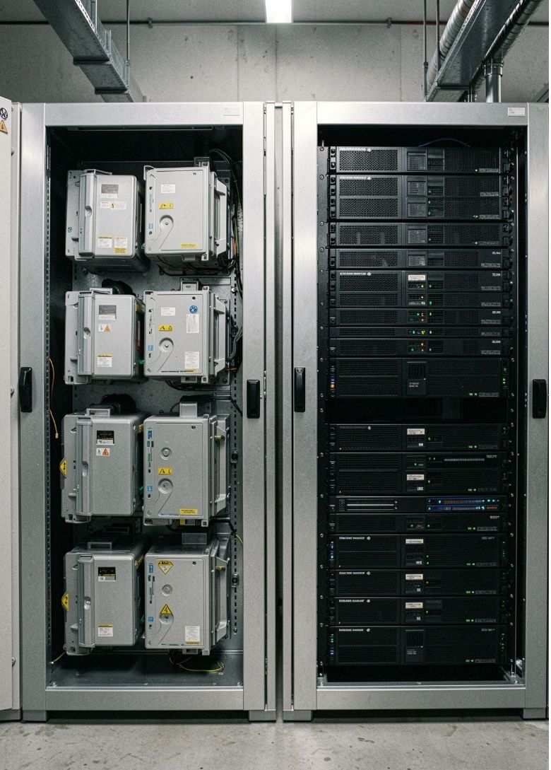
Containers vs Virtual Machines
 | Containers | Virtual Machines
Operating system | Share the host kernel | Each VM runs its own guest OS
Resource usage | Usually lower overhead | Usually higher overhead
Startup time | Generally seconds or less | Often longer
Isolation | Process-level isolation | Separate virtual hardware and guest OS
Portability | Portable with compatible container runtime | Portable with compatible hypervisor
Best suited for | Microservices and application deployment | Different operating systems and stronger workload separation
A developer may use containers to deploy multiple web services efficiently, while a company may use virtual machines to run separate Linux and Windows environments on the same physical server.
Containers virtualize the operating system environment, whereas virtual machines virtualize hardware and run separate guest operating systems.
PROJECT LEDGER
PUBLIC INTEREST REPORT
06 / 10

Slide 7
Benefits and Limitations
Benefits
Limitations
Efficient resource usage: Multiple applications can share one kernel.
Fast deployment: Containers can be started and replaced quickly.
Portability: Applications can move between compatible environments.
Scalability: More application instances can be created when demand increases.
Consistency: Dependencies can be packaged with applications.
Shared-kernel dependency: Containers generally cannot run a different kernel from the host directly.
Security concerns: A kernel vulnerability may affect multiple containers.
Resource contention: Applications can compete for CPU and memory.
Management complexity: Large deployments need monitoring and orchestration.
Persistent storage: Data must be managed carefully when containers are replaced.
Containers improve deployment efficiency, but security, monitoring, and resource management remain essential.
PROJECT LEDGER
PUBLIC INTEREST REPORT
07 / 10

Slide 8

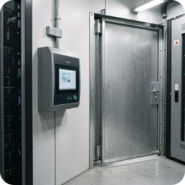


Real-World Applications
Example scenario: Online Shopping Application
Web Hosting: Run separate website components in individual containers.
Microservices: Deploy authentication, payments, notifications, and other services independently.
Continuous Integration and Deployment (CI/CD): Create consistent environments for testing and deploying software.
Cloud Platforms: Cloud providers use virtualization technologies to deliver scalable computing services. Container-based workloads may run on virtual machines or other managed infrastructure.
Development and Testing: Developers can reproduce application environments across different computers and servers.
Container 1: Product catalogue
Container 2: User authentication
Container 3: Payment service
Container 4: Notification service
If traffic increases, additional instances of selected services can be deployed without duplicating the entire application.
PROJECT LEDGER
PUBLIC INTEREST REPORT
08 / 10

Slide 9
Summary and Key Takeaways
01
02
Cloud infrastructure provides the resources, while OS-level virtualization helps package, isolate, and deploy applications efficiently on those resources.
Cloud computing provides computing resources over a network.
Cloud platforms manage resources across large-scale infrastructure.
Why might a company choose containers instead of running every application in a separate virtual machine?
03
04
OS-level virtualization creates isolated application environments that share a host kernel.
Containers generally use fewer resources than full virtual machines.
05
06
Containers support portability, rapid deployment, and scalable application architectures.
Security, monitoring, and resource limits are necessary for reliable deployment.
PROJECT LEDGER
PUBLIC INTEREST REPORT
09 / 10

Slide 10
References
Abraham Silberschatz, Peter B. Galvin, and Greg Gagne, Operating System Concepts, Wiley.
Docker Documentation — What is a Container? https://docs.docker.com/get-started/docker-concepts/the-basics/what-is-a-container/
Linux Kernel Documentation — Control Group v2 https://docs.kernel.org/admin-guide/cgroup-v2.html
Linux Kernel Documentation — Namespaces https://man7.org/linux/man-pages/man7/namespaces.7.html
Microsoft Azure — What is Cloud Computing? https://azure.microsoft.com/en-us/resources/cloud-computing-dictionary/what-is-cloud-computing/
PROJECT LEDGER
PUBLIC INTEREST REPORT
10 / 10

